Slide 1

UNIVERSITY INSTITUTE OF ENGINEERING
COMPUTER SCIENCE ENGINEERING
Bachelor of Engineering (Computer Science & Engineering)
Subject Name: Block chain Technology
Subject Code: CSA-467
Challenges in bit coin
Mapped with CO3
Prepared By:
Er. Ankita Sharma
DISCOVER . LEARN . EMPOWER

Slide 2
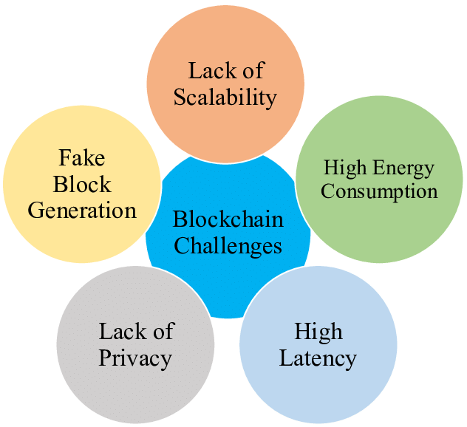
Challenges in bit coin

Slide 3
Low Scalability
With the amount of transactions increasing day by day, the block chain becomes heavy.
All transactions have to be stored for validating the transaction.
Besides, due to the original restriction of block size(1 MB) and the time interval used to generate a new block, the Bitcoin block chain can only process nearly 7 transactions per second, which cannot fulfil the requirement of processing millions of transactions in a real-time fashion.
Meanwhile, as the capacity of blocks is very small, many small transactions might be delayed since miners prefer those transactions with a high transaction fee.

Slide 4
Privacy leakage
The block chain is believed to be very safe as users only make transactions with generated addresses rather than real identity.
Users also could generate many addresses in case of information leakage.
and balances for each public key are publicly visible.
Besides, the recent study (Barcelo, 2014) has shown that a user’s Bitcoin transactions can be linked to reveal user’s information.

Slide 5
High Energy Consumption
Energy consumption is another block chain adoption challenge. Most of the block chain technology follow bitcoins infrastructure and use Proof of Work as a consensus algorithm.
However, Proof of Work is not as great as it looks. To keep the system live, it will need computational power. You probably heard about mining.
Mining will require you to solve complex equations using your computer. So, your PC will take more and more electricity to overcome this situation when you start mining.
At present, miners are using 0.2% of the total electricity. If it keeps increasing then, miners will take more power than the world can provide. Thus, it now becomes one of the primary challenges of this network.

Slide 6
Security Problems
Like any other technology, block chain also comes with a few security loopholes.
The 51% attack on the network is one of the security flaws of the network.
In this attack, hackers can take over the network and exploit it in their way.
They can even alter the transaction process and restrict other people from creating a block.

Slide 7
Lack of Adequate Skill Sets
As you know, block chain technology is relatively new and is still evolving. At the moment, few people have the skills to support such technology.
On the other hand, the demand for this qualified staff is enormous. So, if you want to hire skilled people, you’ll have to pay up large salaries. The right people will cost you.

Slide 8
Thankyou

